Slide 1

Weather Application
Ander Jors, Martin Lohmus, Xuejun Wu

Slide 2
Basic Functionalities
Display the weather of user’s location
Allow user to choose up to three different cities
User can navigate through different fragments to find the weather of cities they choose
Allow user to change the style of the application(dark & light mode)
Using a widget to display weather to the user

Slide 3
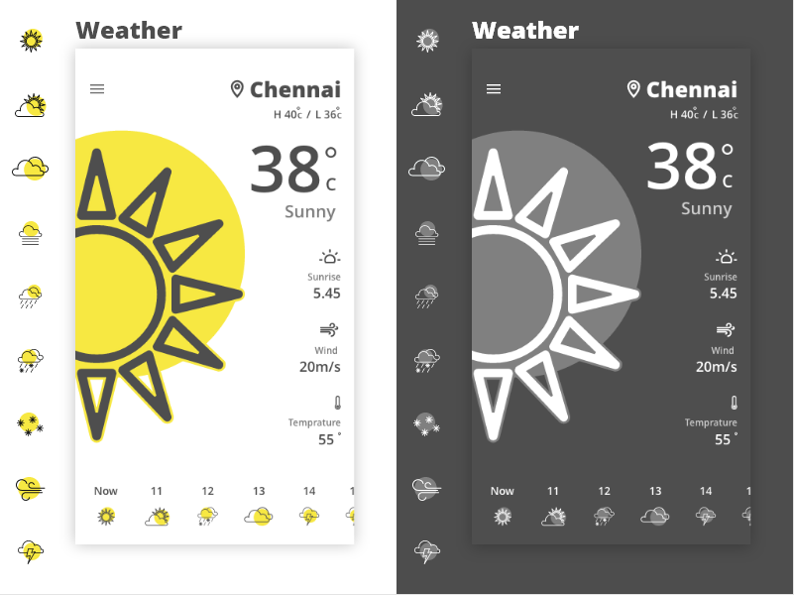
Prototype

Slide 4
Core Blocks
There will be multiple fragments or activities to display weather of different cities
The function setting screen will allow user to choose cities, change application appearance.
Corouting will be used to update weather of cities choosen.

Slide 5
Feature Blocks
GPS will be used to locate the location of user
Widget will be used to display weather information
Web Restful API will be used to get weather information(openweathermap)
Service may be used to gather weather information

Slide 6
Work Division
UI design (Martin)
Main Functionalities (Xuejun)
API and setting (Ander)
We will adjust the work division based on the workload of each part

